Slide 1
Chapter 2: MOS Device Physics
2.1 General Considerations
2.2 MOS I/V Characteristics
2.3 Second-Order Effects
2.4 MOS Device Models
2.5 Appendix A: FinFETs
2.6 Appendix B: Behavior of MOS
Device as a Capacitor

Slide 2
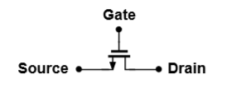
MOSFET as a Switch
When gate voltage is high, device is on.
Source and drain are interchangeable.
But,
- At what gate voltage does the device turn on?
- How much is the resistance between S and D?
- What limits the speed of the device?

Slide 3
MOSFET Structure
n-type MOS (NMOS) has n-doped source (S) and drain (D) on p-type substrate (“bulk” or “body”).
S/D junctions “side-diffuse” during fabrication so that effective length L_{eff} = L_{drawn} − 2L_{D} .
Typical values are L_{eff} ≈ 10 nm and t_{ox} ≈ 15 Å.
The S terminal provides charge carriers and the D terminal collects them.
As voltages at the three terminals changes, the source and drain may exchange roles.

Slide 4
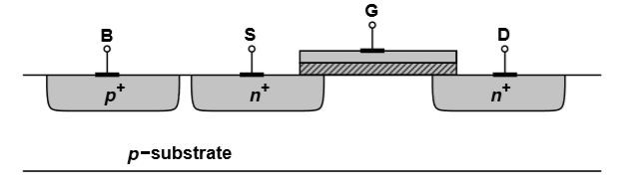
MOSFET Structure
MOSFETs actually have four terminals.
Substrate potential greatly influences device characteristics.
Typically S/D junction diodes are reversed-biased and the NMOS substrate is connected to the most negative supply in the system.

Slide 5
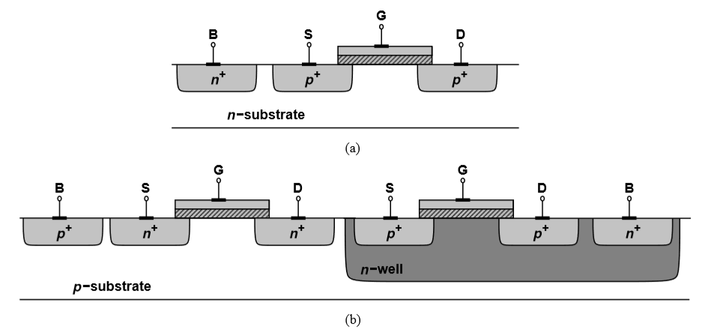
MOSFET Structure
PMOS is obtained by inverting all of the doping types (including the substrate).

Slide 6
MOSFET Structure
In complementary MOS (CMOS) technologies both NMOS (NFET) and PMOS (PFET) are needed and fabricated on the same wafer.
In today’s CMOS, the PMOS is fabricated in an n-well, where the n-well is tied to the most positive supply voltage.

Slide 7
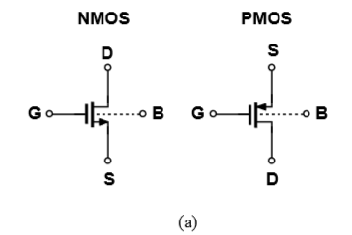
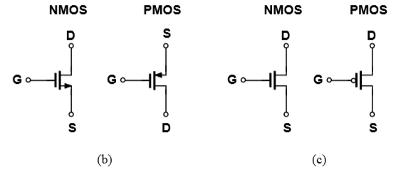
MOS Symbols
Substrate is denoted by “B” (bulk).
PMOS source is positioned on top since it has a higher potential than the gate.
Most circuits have NMOS and PMOS bulk tied to ground and V_{DD}, respectively, so we tend to omit the connections (b,c).
Digital circuits tend to incorporate “switch” symbols (c).

Slide 8
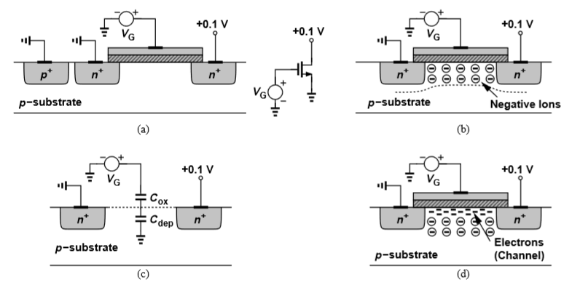
Threshold Voltage
As V_{G} increases from zero, holes in p-substrate are repelled leaving negative ions behind to form a depletion region.
There are no charge carriers, so no current flow.

Slide 9
Threshold Voltage
Increasing V_{G} further increases the width of the depletion region and the potential at the oxide-silicon interface.
Structure resembles voltage divider consisting of gate-oxide capacitor and depletion region capacitor in series.

Slide 10
Threshold Voltage
When interface potential reaches sufficiently positive value, electrons flow from the source to the interface and eventually to the drain.
This creates a channel of charge carriers (inversion layer) beneath the gate oxide.
The value of V_{G} at which the inversion layer occurs is the threshold voltage (V_{TH}).

Slide 11


Threshold Voltage
Where
- Φ_{MS} is the difference between the work functions of the polysilicon gate and the silicon substrate.
- k is Boltzmann’s constant.
- q is the electron charge.
- N_{sub} is the doping density of the substrate.
- n_{i} is the density of electrons in undoped silicon.
- Q_{dep} is the charge in the depletion region.
- C_{ox} is the gate oxide capacitance per unit area.
- є_{si} is the dielectric constant of silicon.

Slide 12
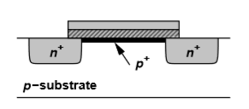
Threshold Voltage
In practice, threshold voltage is adjusted by implanting dopants into the channel area during device fabrication.
For NMOS, adding a thin sheet of p⁺ increases the gate voltage necessary to deplete the region.

Slide 13
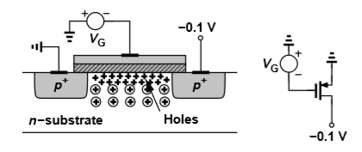
Threshold Voltage
Turn-on phenomena in PMOS is similar to that of NMOS but with all polarities reversed.
If the gate-source voltage becomes sufficiently negative, an inversion layer consisting of holes is formed at the oxide-silicon interface, providing a conduction path between source and drain.
PMOS threshold voltage is negative.

Slide 14
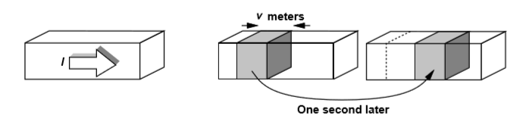
Derivation of I/V Characteristics
Where
- Q_{d} is the mobile charge density along the direction of current I.
- v is the charge velocity.

Slide 15
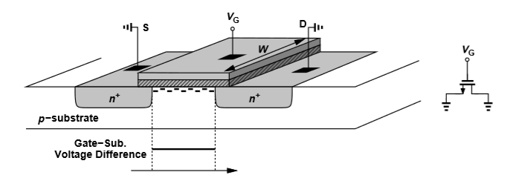
Derivation of I/V Characteristics
Onset of inversion occurs at V_{GS} = V_{TH}.
Inversion charge density produced by gate oxide capacitance is proportional to V_{GS} − V_{TH} since for V_{GS} ≥ V_{TH}, charge placed on the gate must be mirrored by charge in the channel, yielding a uniform channel charge density:
Where WC_{ox} is the total capacitance per unit length.

Slide 16
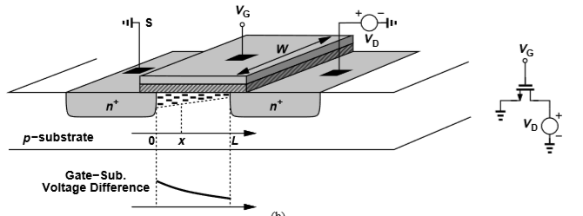
Derivation of I/V Characteristics
Channel potential varies from zero at the source to V_{D} at the drain.
Local voltage difference between the gate and the channel varies from V_{G} to V_{G} − V_{D}.
Charge density now varies with respect to x :
,
where V(x) is the channel potential at x.

Slide 17


Derivation of I/V Characteristics
Since
-
-
-
-
-
-
A negative sign is added because the charge carriers are negative for NMOS.

Slide 18
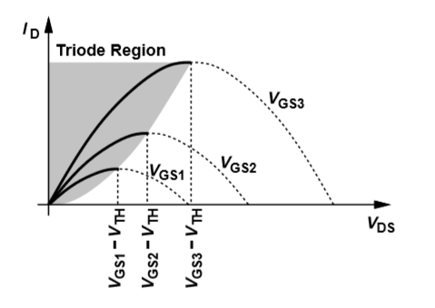

Derivation of I/V Characteristics
.
.
V_{GS}−V_{TH} is known as the “overdrive voltage.”
W/L is known as the “aspect ratio.”
If V_{DS} ≤ V_{GS}−V_{TH}, we say the device is operating in the “triode region.”

Slide 19
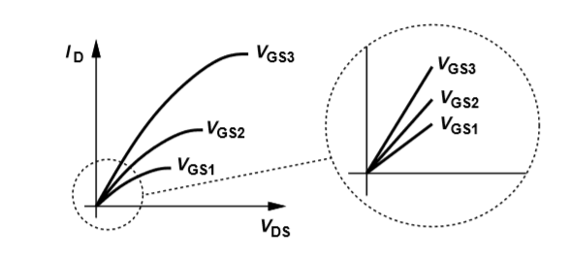


Derivation of I/V Characteristics
If V_{DS} << 2(V_{GS}−V_{TH}), then
In this case, the drain current is a linear function of V_{DS} so the path from source to drain can be represented by a linear resistor:

Slide 20
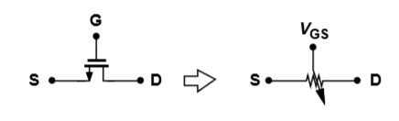
Derivation of I/V Characteristics
If V_{DS} << 2(V_{GS}−V_{TH}), the device is operating in “deep triode region.”
In this region, a MOSFET can operate as a resistor whose value is controlled by the overdrive voltage.
Unlike bipolar transistors, a MOS device may be on even if it carries no current.

Slide 21
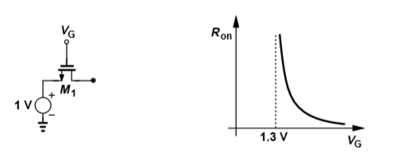
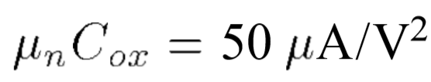


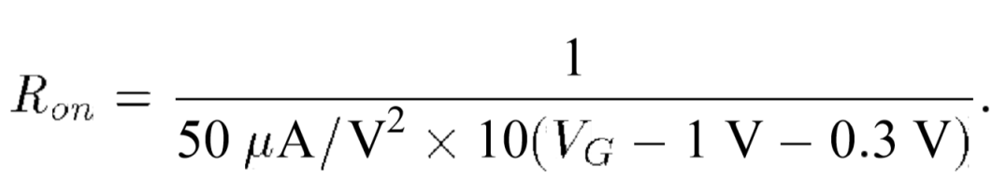
Derivation of I/V Characteristics
For example, given the topology on the left and that
- ,
- ,
- ,

Slide 22
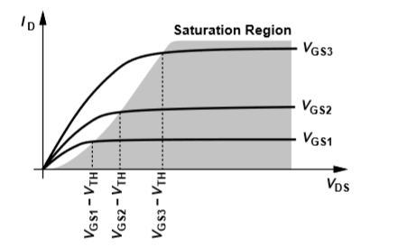
Derivation of I/V Characteristics
In reality, if V_{DS} > V_{GS}−V_{TH}, I_{D} becomes relatively constant and we say that the device operates in “saturation region.”
V_{D,sat} = V_{GS}−V_{TH} denotes the minimum V_{DS} necessary for operation in saturation.

Slide 23
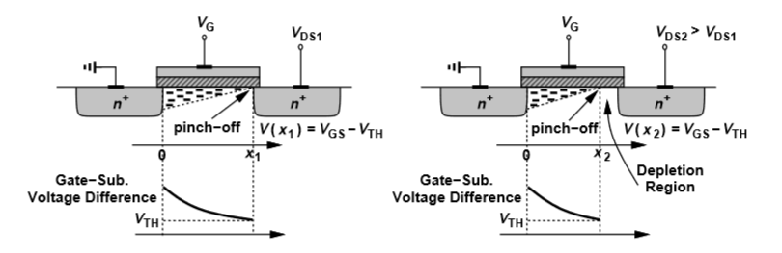
Derivation of I/V Characteristics
If V_{DS} is slightly larger than V_{GS}−V_{TH}, the inversion layer stops at x ≤ L, and the channel becomes “pinched off.”
As V_{DS} increases, the point at which Q_{D} equals zero gradually moves towards the source.
At some point along the channel, the local potential difference between the gate and the oxide-silicon interface is not sufficient to support an inversion layer.

Slide 24
Derivation of I/V Characteristics
Electron velocity ( ) rises tremendously as they approach the pinch-off point (where ) and shoot through the depletion region near the drain junction and arrive at the drain terminal.

Slide 25
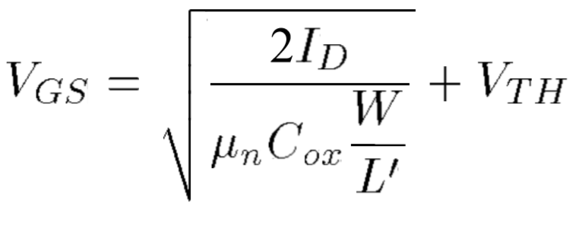


Derivation of I/V Characteristics
Since the integral becomes
-
-
I_{D} is relatively independent of V_{DS} if L’ remains close to L.
The device exhibits a “square-law” behavior.

Slide 26
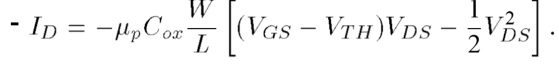

Derivation of I/V Characteristics
For PMOS devices, the equations become
The negative sign shows up due to the assumption that drain current flows from drain to source, whereas holes in a PMOS flow in the reverse direction.
V_{GS}, V_{DS}, V_{TH}, and V_{GS}−V_{TH} are negative for a PMOS transistor that is turned on.
Since the mobility of holes is about ½ the mobility of electrons, PMOS devices suffer from lower “current drive” capability.

Slide 27
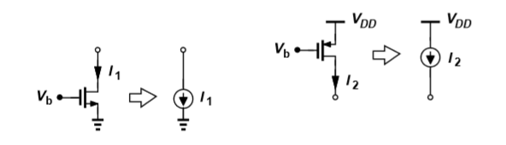
Derivation of I/V Characteristics
A saturated MOSFET can be used as a current source connected between the drain and the source.
NMOS current sources inject current into ground while PMOS current sources draws current from V_{DD}.

Slide 28
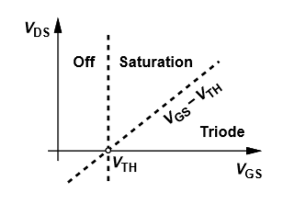
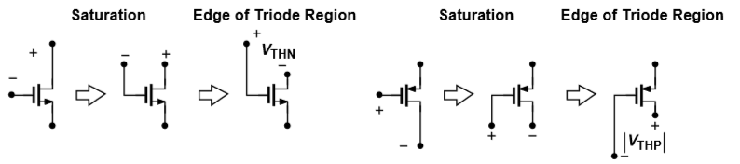
Derivation of I/V Characteristics
V_{DS} = V_{GS}−V_{TH} = V_{D,sat} is the line between saturation and triode region.
For a given V_{DS}, the device eventually leaves saturation as V_{GS} increases.
The drain is defined as the terminal with a higher (lower) voltage than the source for an NMOS (PMOS).

Slide 29
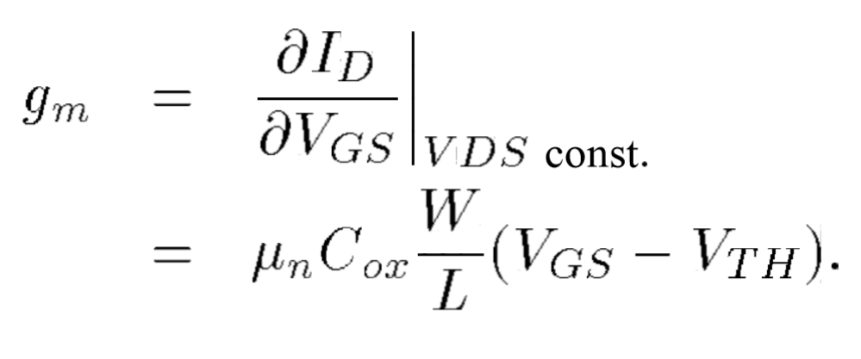
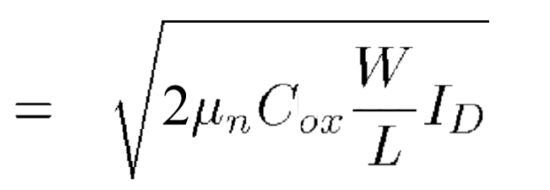

MOS Transconductance
Transconductance (usually defined in the saturation region) is defined as the change in drain current divided by the change in the gate-source voltage.
g_{m} represents the sensitivity of the device since a high value implies a small change in V_{GS} will result in a large change in I_{D}.
Transconductance in saturation region is equal to the inverse of R_{on} in the deep triode region.

Slide 30
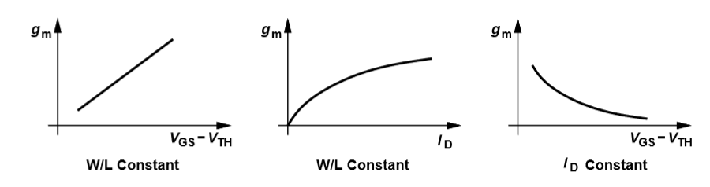
MOS Transconductance
Each expression for transconductance is useful in studying its behavior.
Drain current and overdrive voltage are bias values.
If a small signal is applied to a device with defined bias values, we assume the signal amplitude is small enough that the variation in transconductance is negligible.

Slide 31
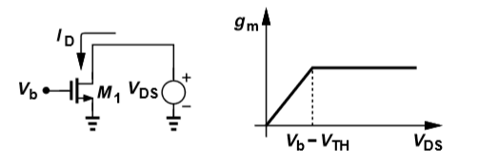
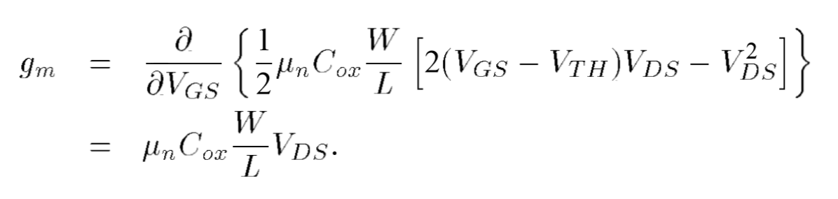
MOS Transconductance
To find the transconductance for the topology on the left with respect to V_{DS},
- So long as V_{DS} ≥ V_{b} − V_{TH}, M₁ is in saturation, so I_{D} is relatively constant, and therefore so is g_{m}.
- When M₁ enters triode region
(V_{DS} < V_{b} − V_{TH}),

Slide 32



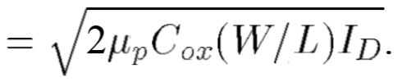
MOS Transconductance
For PMOS,

Slide 33
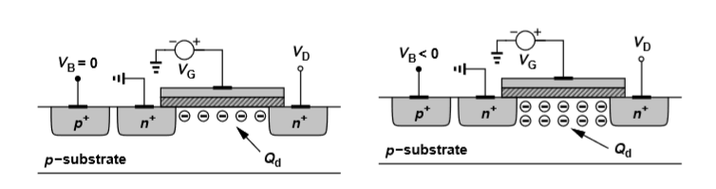
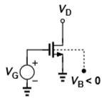
Second-Order Effects
Originally, with the bulk of an NMOS tied to ground, the threshold voltage was defined as
Decreasing the bulk voltage (V_{B}) increases the number of holes attracted to the substrate connection, which leaves a larger negative charge behind and makes the depletion region wider, increasing Q_{d} and thus increasing V_{TH}.
This is known as the “body effect” or “back-gate effect.”

Slide 34
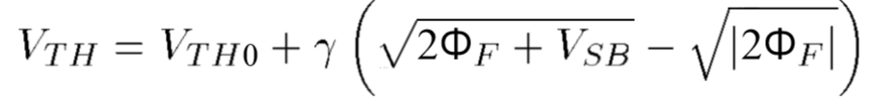

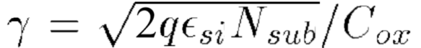
Second-Order Effects
With body effect, the expression which characterizes the dependence of threshold voltage on the bulk voltage is
Where,
-
- denotes the body effect coefficient.

Slide 35
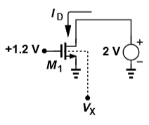
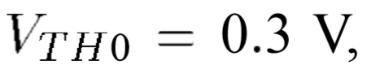
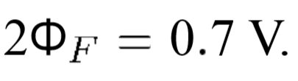
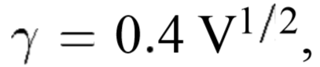

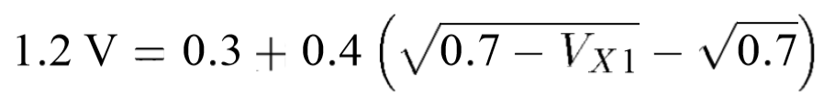

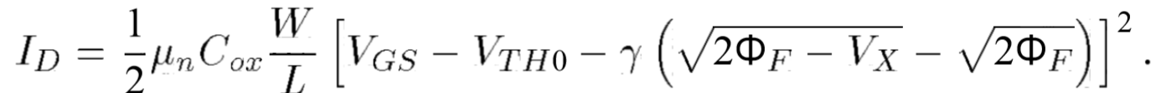
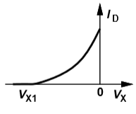
Second-Order Effects
For example, let's find the drain current as bulk voltage varies from negative infinity to 0 given the topology on the left and that
-
-
-
If V_{X} is sufficiently negative, V_{TH} of M₁ exceeds 1.2 V and the device is off, therefore , where
-
-

Slide 36
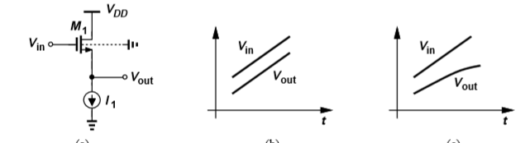
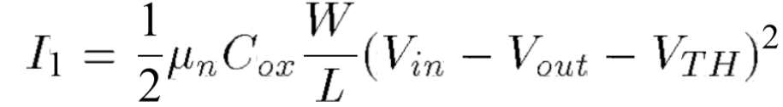
Second-Order Effects
Body effect manifests itself whenever the source voltage varies with respect to the bulk potential.
Given the topology on the left and first ignoring body effect, as V_{in} varies, V_{out} follows the input because the drain current remains equal to I₁, where
With body effect, as V_{in,out} become more positive, V_{SB} increases, which increases V_{TH} and thus V_{in} – V_{out} must increase to maintain a constant I_{D}.

Slide 37
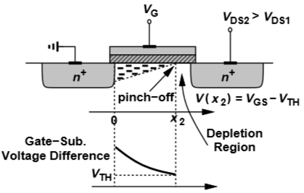
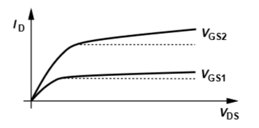
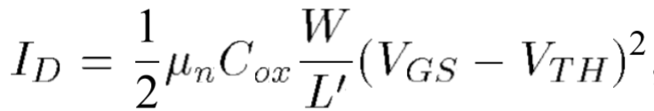
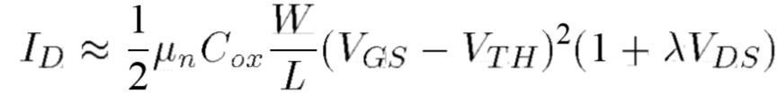
Second-Order Effects
Originally, when the device was in saturation region, drain current was characterized by
The actual length of the channel (L’ = L − ΔL) is a function of V_{DS}, which is an effect called “channel length modulation.”
1/L’ ≈ (1 + ΔL/L)/L, and ΔL/L = λV_{DS}, where λ is the channel-length modulation coefficient” gives us

Slide 38
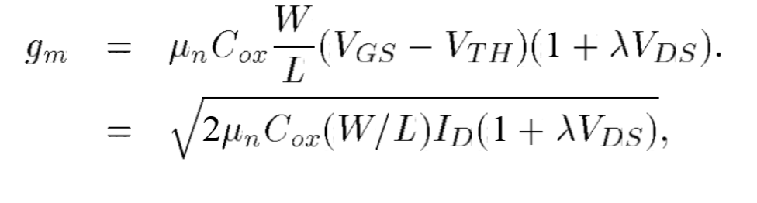
Second-Order Effects
With the effect of channel length modulation, the expressions derived for transconductance of the device that need modification are

Slide 39
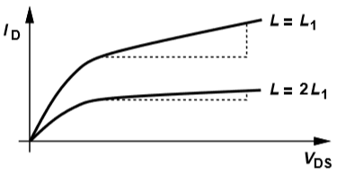
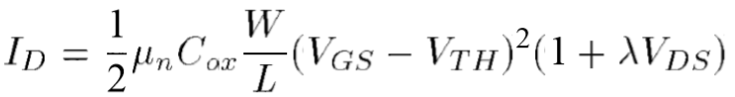


Second-Order Effects
Knowing that
-
-
and keeping all other parameters constant, we can see that if the length L is doubled, the slope of I_{D} vs. V_{DS} is divided by four.
This is due to .

Slide 40


Second-Order Effects
MOSFETs do not turn off abruptly when V_{GS} < V_{TH}, but actually there is a “weak” inversion layer that exists and finite current flows from drain to source with an exponential dependence on V_{GS}.
This effect is called “subthreshold conduction.”
When V_{GS} < V_{TH},
where I₀ W/L, ξ > 1 is a nonideality factor, and
V_{T} = kT/q.
Here the device operates in “weak inversion.”

Slide 41

Second-Order Effects
To examine MOSFET behavior as the drain “current density,” I_{D}/W varies, we must consider the equations for both strong and weak inversion:
For a given current and W/L, we must obtain V_{GS} from both expressions and select the lower value.
If I_{D} remains constant and W increases, V_{GS} falls and the device goes from strong to weak inversion.

Slide 42
Second-Order Effects
MOSFETs experience undesirable effects if terminal voltage differences exceed certain limits, e.g.
- If V_{GS} is too high, the gate oxide breaks down irreversibly, damaging the transistor.
- In short channel devices, excessively large V_{DS} widens depletion region around the drain so that it touches the depletion region around the source, creating a very large drain current (an effect called “punchthrough”).

Slide 43

MOS Device Layout
The gate polysilicon and the source and drain terminals must be tied to metal (aluminum) wires that serve as interconnects with low resistance and capacitance.
This is accomplished with “contact windows” which are filled with metal and connected to the upper metal wires.
To minimize the capacitance of the source and drain, the total area of each junction must be minimized.

Slide 44

MOS Device Layout
Since M₁ and M₂ share the same S/D junctions at node C and M₂ and M₃ do the same at node N, we can lay them out as shown above.
Since the gate polysilicon of M₃ cannot be directly tied to the source material of M₁, a metal interconnect is necessary.

Slide 45

MOS Device Capacitances
To better predict high-frequency behavior, it is necessary to consider device capacitances.
Capacitance exists between every two of the four terminals, and their values depend on the bias conditions of the transistor.

Slide 46

MOS Device Capacitances
Capacitances include
- The oxide capacitance between the gate and the channel C₁.
- The depletion capacitance between the channel and the substrate C₂.
- The capacitance due to the overlap of the gate poly with the source and drain areas C₃ and C₄.
- The junction capacitance between the source/drain areas and the substrate C₅ and C₆.

Slide 47


MOS Device Capacitances
Due to fringing electric fields, C₃ and C₄ cannot be written as WL_{D}C_{ox}; rather we must find the overlap capacitance per unit width (C_{ov}) and multiply that value with W.

Slide 48

MOS Device Capacitances
C₅ and C₆ are decomposed into two components:
- The bottom-plate capacitance associated with the bottom of the junction, Cj:
where V_{R} is the reverse voltage across the junction, Φ_{B} is the junction built-in potential, and m is a power typically in the range of 0.3 and 0.4.
- The sidewall capacitance due to the perimeter of the junction, C_{jsw}.

Slide 49



MOS Device Capacitances
For example calculating the source and drain junction capacitance of the topology on the left,
Calculating the source and drain junction capacitance of the second topology on the left,
We assumed the total source/drain perimeter 2(W+E) is multiplied by C_{jsw}.

Slide 50



MOS Device Capacitances
Considering capacitance values in different operating regions, if the device is off,
-
- where L is the effective length, and є_{si} = є_{r,si} x є₀ = 11.8 x (8.85 x 10⁻¹⁴) F/cm.
- The values of C_{SB} and C_{DB} are a function of the source and drain voltages with respect to the substrate.

Slide 51

MOS Device Capacitances
In deep triode region, the source/drain have approximately equal voltages, so the gate-channel capacitance WLC_{ox} is divided equally between the gate-source terminals and the gate-drain terminals, which results in
C_{GB} is usually neglected in triode and saturation regions because the inversion layer acts as a “shield” between the gate and the bulk, so if V_{G} varies, the charge is supplied by the source/drain rather than the bulk.

Slide 52

MOS Device Capacitances
If the device is in saturation region, C_{GD} will be roughly equal to WC_{ov}.
The varying potential difference between gate and channel cause nonuniform vertical electric field in the gate oxide while going from source to drain, which results in C_{GS} being

Slide 53




MOS Device Capacitances
Lets sketch the capacitance of M₁ on the left as V_{X} varies from 0 to 3 V assuming V_{TH} = 0.3 V and λ = γ = 0.
- For V_{X} ≈ 0, M₁ is in triode region, so C_{FB} is maximum, and
- As V_{X} exceeds 1 V, the roles of the source/drain are exchanged, bringing M₁ out of the triode region for V_{X} ≥ 2 V − 0.3 V.
- C_{NB} is independent of V_{X}.

Slide 54

MOS Small-Signal Model
If perturbation in bias conditions are small, a “small-signal” model can be used to simplify calculations (derived for saturation region).
In order to derive the small-signal model, we
- Apply certain bias voltages to the terminals of the device.
- Increment the potential difference between two of the terminals while the other terminal voltages remain constant.
- Measure the resulting change in all terminal currents.

Slide 55
MOS Small-Signal Model
By changing the voltage between two terminals by ΔV = V_{GS} and then measuring a current change ΔI = g_{m}V_{GS}, we can model the effect by a voltage-dependent current source.
Above is the small-signal model of an ideal MOSFET.

Slide 56



MOS Small-Signal Model
Due to channel-length modulation, drain current also varies with V_{DS} , but a current source whose value linearly depends on the voltage across it is equivalent to a linear resistor:
\
It is assumed that λV_{DS} << 1.
r_{o} limits the maximum voltage gain of most amplifiers.

Slide 57



MOS Small-Signal Model
Due to body effect, bulk potential influences V_{TH} and hence gate-source overdrive.
With all other terminals held at a constant voltage, the bulk behaves as a second gate since the drain current is a function of the bulk voltage given by g_{mb}V_{BS}, where

Slide 58

MOS Small-Signal Model
The small-signal model above is adequate for most low-frequency small-signal analyses.
In reality, each terminal exhibits a finite ohmic resistance due to resistivity of the material (and contacts), but proper layout can minimize these resistances.
- Folding reduces the gate resistance by a factor of four.

Slide 59

MOS Small-Signal Model
The complete MOS small-signal model not only includes channel-length modulation and body effect, but also the capacitances between each terminal.

Slide 60




MOS Small-Signal Model
To sketch g_{m} and g_{mb} of M₁ on the left as a function of bias current I₁,
-
- g_{mb} dependence on I₁ is less straight forward, but as I₁ increases, V_{X} decreases and so does V_{SB}.

Slide 61

MOS Small-Signal Model
The derivation of the small-signal model for PMOS yields the exact same model as for NMOS.
The model shows the voltage-dependent current source pointing upward, giving the (wrong) impression that the direction of the current in the PMOS is opposite of that in NMOS.

Slide 62

MOS Spice Models
Simulators such as SPICE and Cadence need accurate models for each device.
Above is the simplest MOS SPICE model, known as “Level 1,” and provide typical values for each parameter corresponding to 0.5-µm technology.

Slide 63
NMOS versus PMOS Devices
PMOS devices are quite inferior to NMOS in most CMOS technology.
Lower mobility of holes (µ_{p}C_{ox} ≈ 0.5µ_{n}C_{ox}) yield lower current drive and conductance.
NMOS exhibit higher output resistance, providing more ideal current sources and higher gain in amplifiers.
As such is it preferred to incorporate NMOS rather than PMOS wherever possible.

Slide 64

FinFETs
FinFETs have three-dimensional geometry and exhibit superior performance as channel lengths fall below ~20 nm.
Here, W = W_{F} + 2H_{F}, but since H_{F} is not under the circuit designer’s control and W_{F}, impacts device imperfections, there are only discrete values for transistor width.

Slide 65


FinFETs
Spacing between fins, S_{F}, also plays a significant role in performance and is typically fixed.
Due to small dimensions of the intrinsic FinFET, the gate and S/D contacts must be placed away from the core of the device.

Slide 66

Behavior of MOS Devices as a Capacitor
Recall that if source, drain, and bulk are grounded and the gate voltage rises, an inversion layer begins to form for V_{GS} ≈ V_{TH}, and the device operates in the subthreshold region for 0<V_{GS}<V_{TH}.
The transistor can be considered a two-terminal device and we can examine its capacitance for different gate voltages.

Slide 67

Behavior of MOS Devices as a Capacitor
A very negative V_{GS} causes holes to be attracted in the substrate to the oxide interface, and say the MOSFET operates in the “accumulation region” with unit area capacitance of C_{ox}.
As V_{GS} rises, the density of holes at the interface falls, a depletion region begins to form under the oxide, and the device enters weak inversion, causing capacitance to consist of a series combination of C_{ox} and C_{dep}.
As V_{GS} exceeds V_{TH}, the oxide-silicon interface sustains a channel and the unit area capacitance returns to C_{ox}.

